Slide 1
COOTIES!!!!!
Usually, we play as boys vs Girls.
You can take turns or have the kids answer a Bible Question to get a turn.
During a turn, the child picks a spot to uncover. If there’s a number, they get that many points.
If there’s a COOTIE they get no points. We usually play that they can pick multiple dots, but if they get a COOTIE they lose all points collected on that turn and the turn ends.

Slide 2
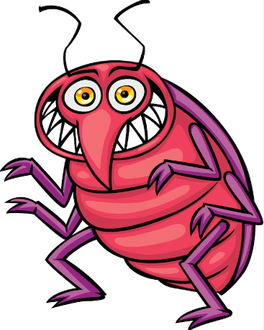
C ties!
8
3
10
7
4
2
5
9
10
6
1
10
4
6
1
3
5
3
7
2
9
8

Slide 3
C ties!
4
8
3
5
7
1
2
10
9
9
6
1
10
6
4
3
5
10
3
7
2
8

Slide 4
C ties!
3
7
2
10
1
1
10
9
9
7
5
10
9
4
3
2
4
2
6
1
5
7

Slide 5
The NEXT slide has the Sound effects removed.
I also moved the green circles to the back
& slightly to the left. This way you can adjust the
points & Cooties to what you want.
It is important to keep the Green Dot paired
With the same circle for the game to work.
Once you have them arranged and how you want Bring green dots back to front & cover the point values.
If you’d like help reach out at
jpelletier@apostolicsofokc.com

Slide 6
C ties!
6
5
10
3
8
4
4
3
2
2
10
3
2
7
6
5
7
5
9
4
8
10

